Slide 1



ECE 477 FINAL REVIEW: TEAM #8
<Add team picture and relevant project picture here>

Slide 2
OUTLINE
Project Overview
Block Diagram
Design Challenges
Individual Contributions
Project Video Demonstration
Questions

Slide 3
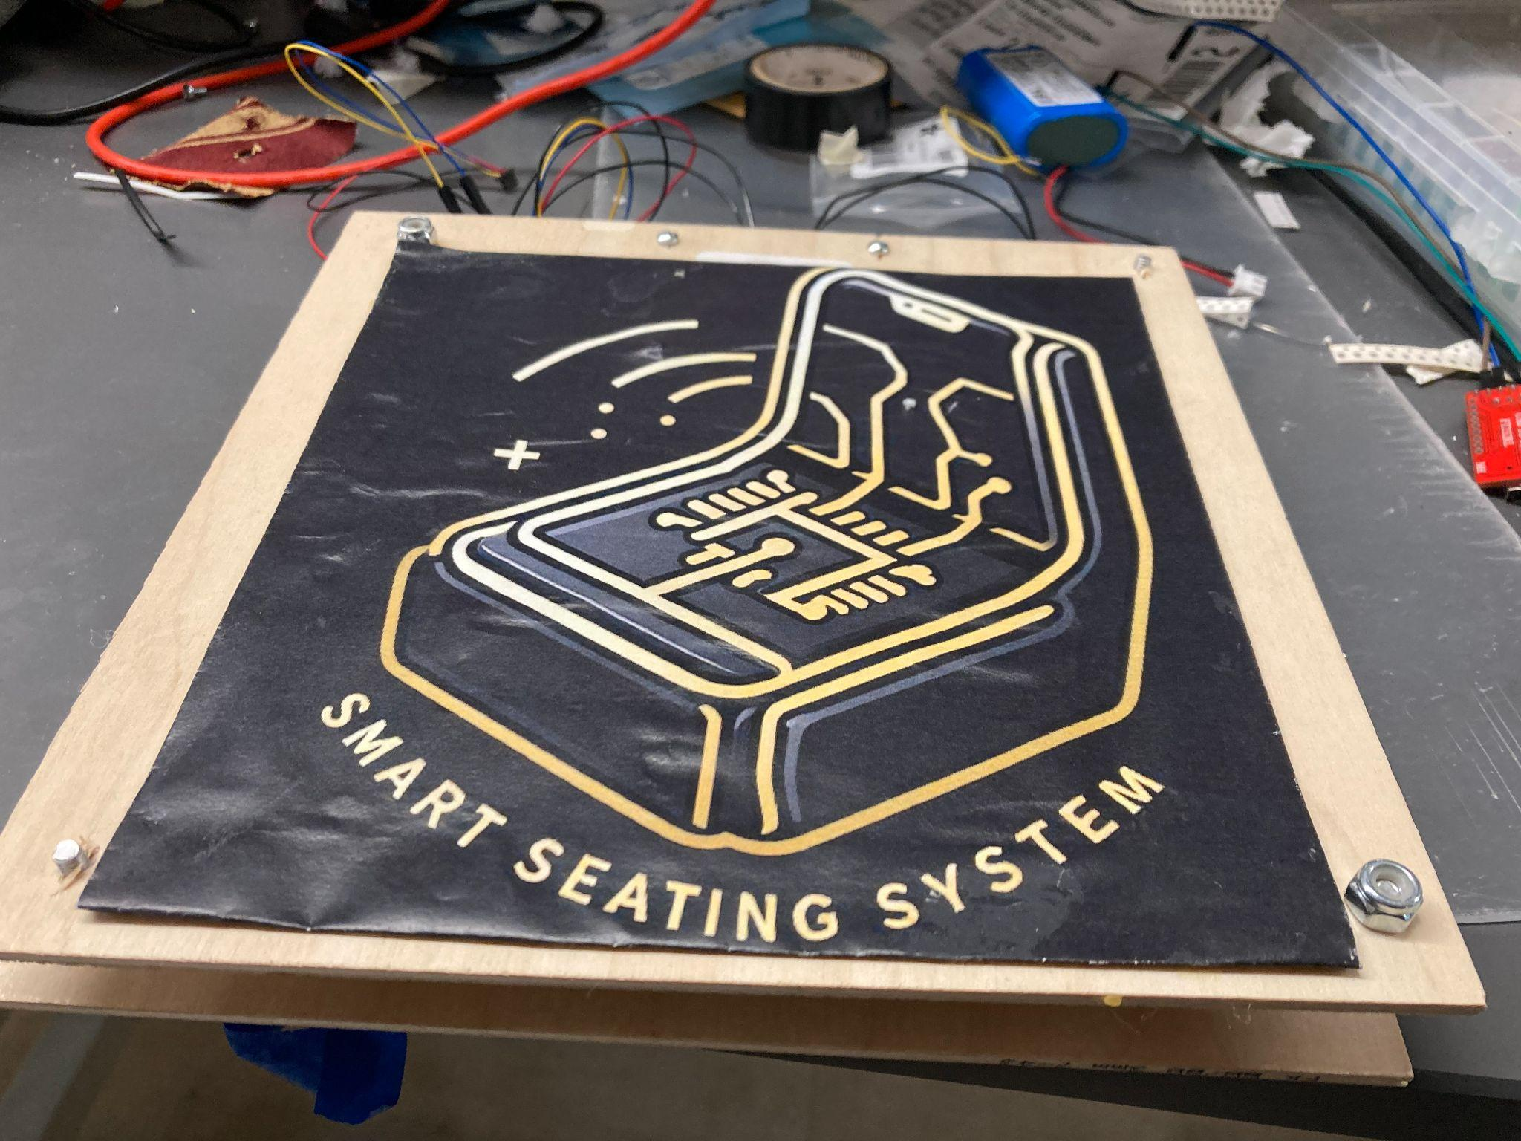
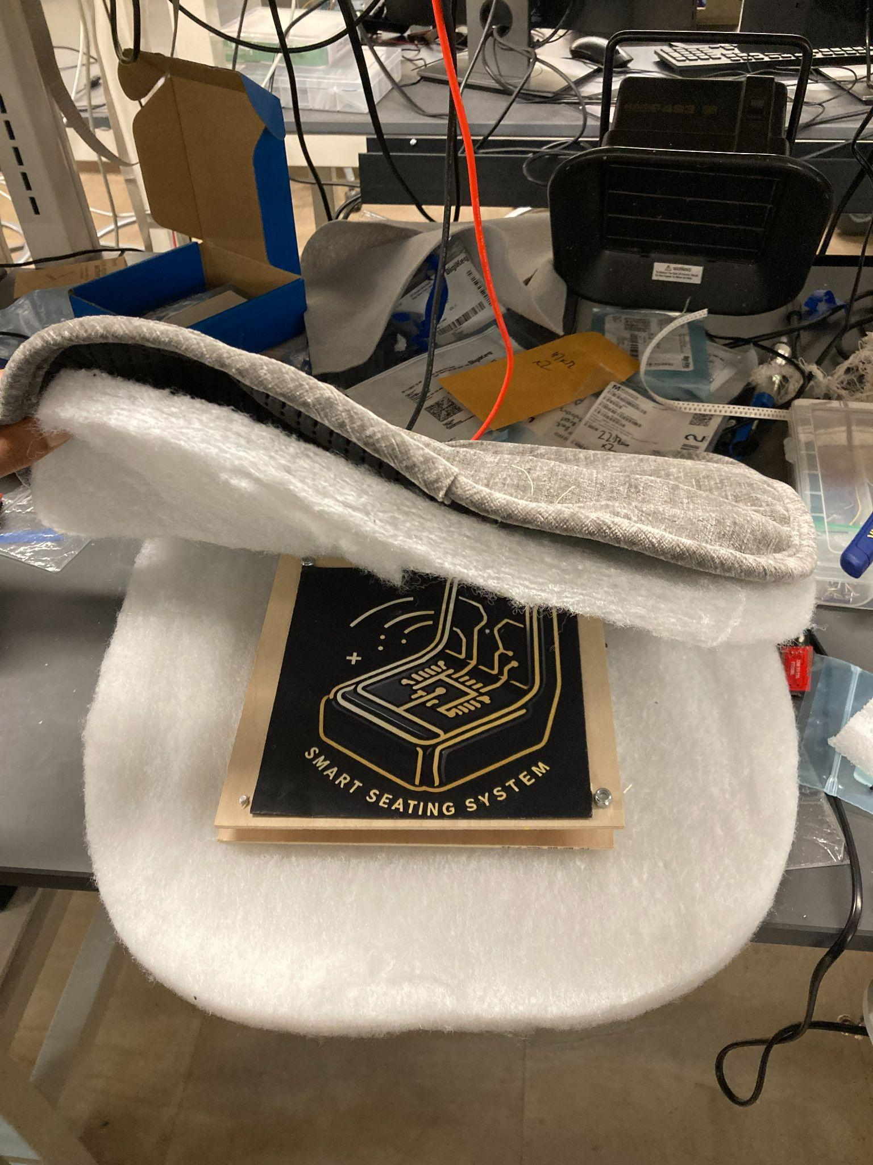
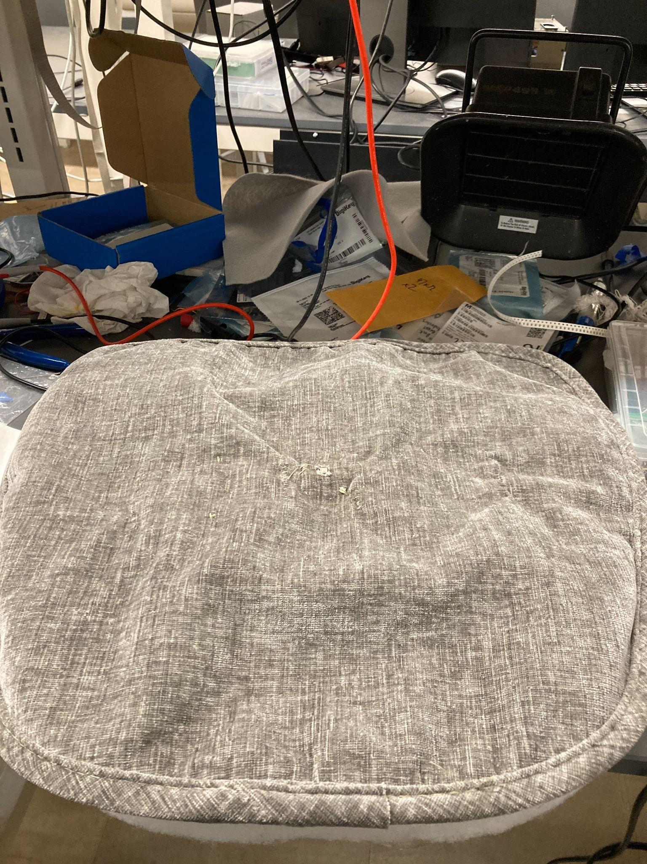
PROJECT OVERVIEW
•The Smart Seating System is a solution designed to address occupancy management
challenges in shared spaces by tracking seating availability in real-time.
•A system that empowers users to make informed decisions about seating availability, enhancing the overall visitor experience, particularly during peak periods in public spaces.

Slide 4
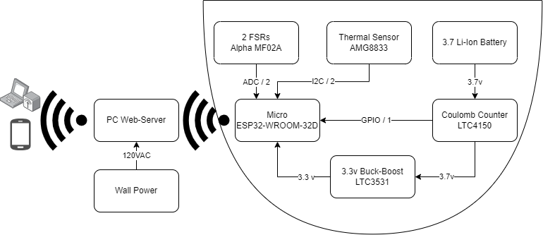
BLOCK DIAGRAM

Slide 5
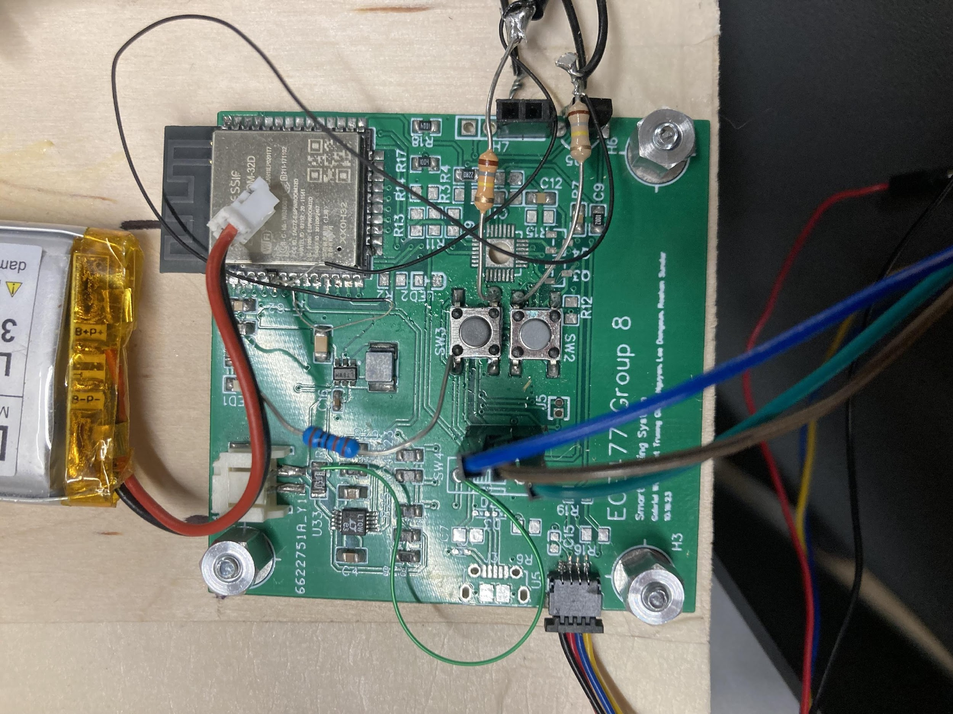

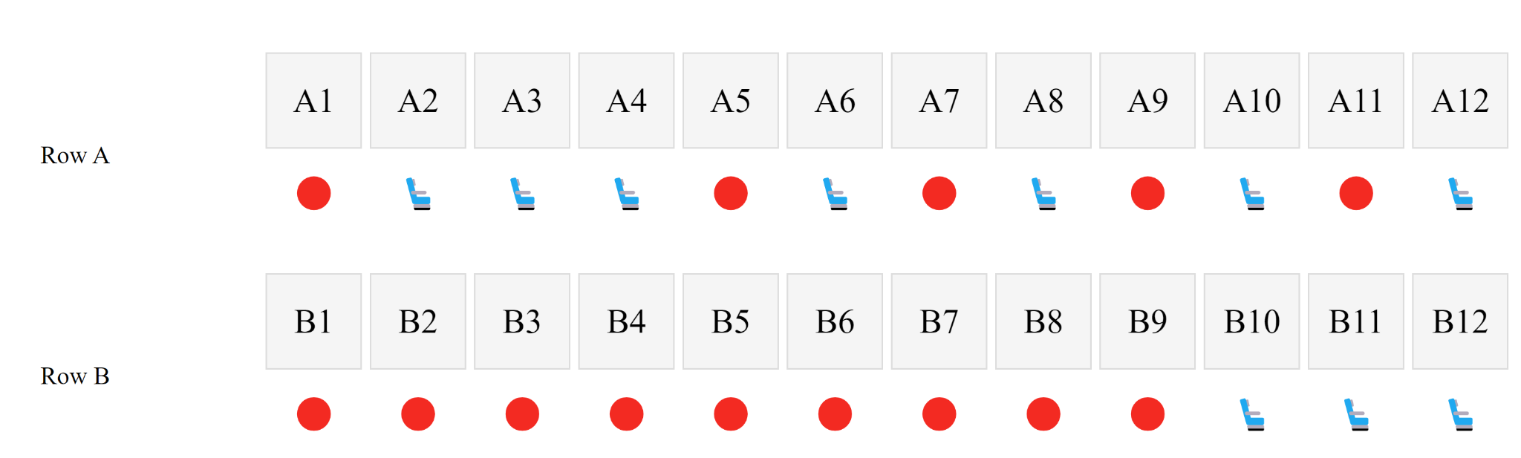
DESIGN CHALLENGES
Debugging ESP32
Debugging Buck Boost
Debugging FSR sensor

Slide 6


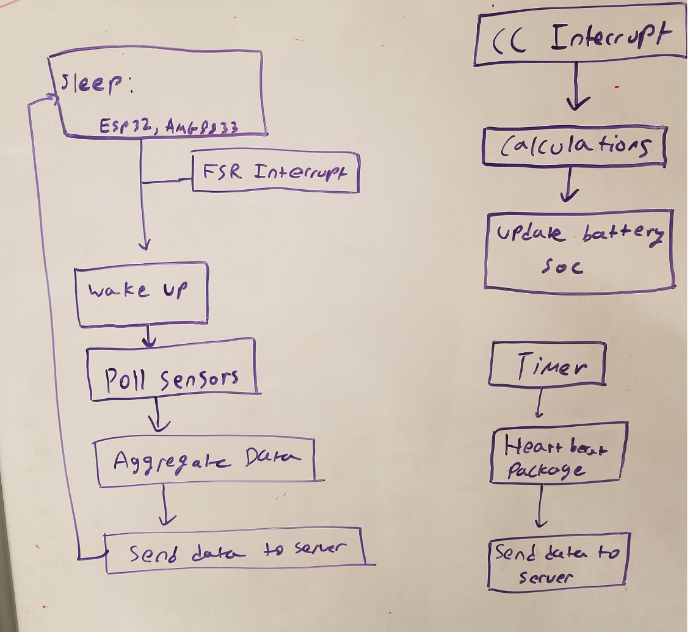
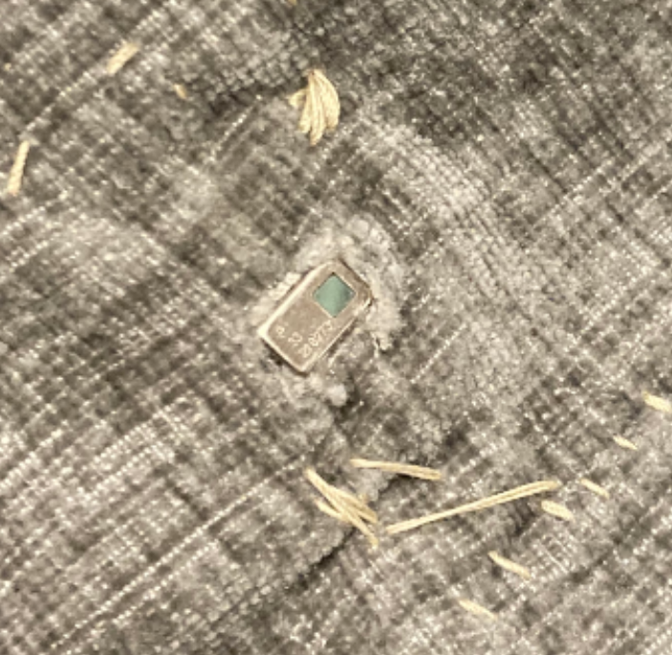

INDIVIDUAL CONTRIBUTIONS
ROSHAN SUNDAR
Firmware Development
Task Management
Networking
Mechanical Design
Sewing

Slide 7
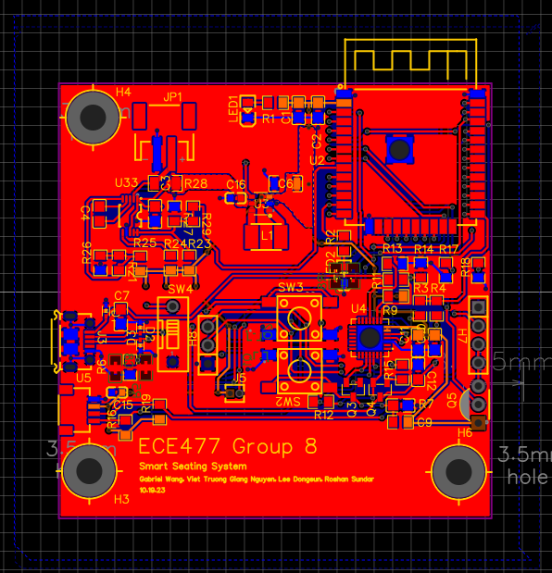
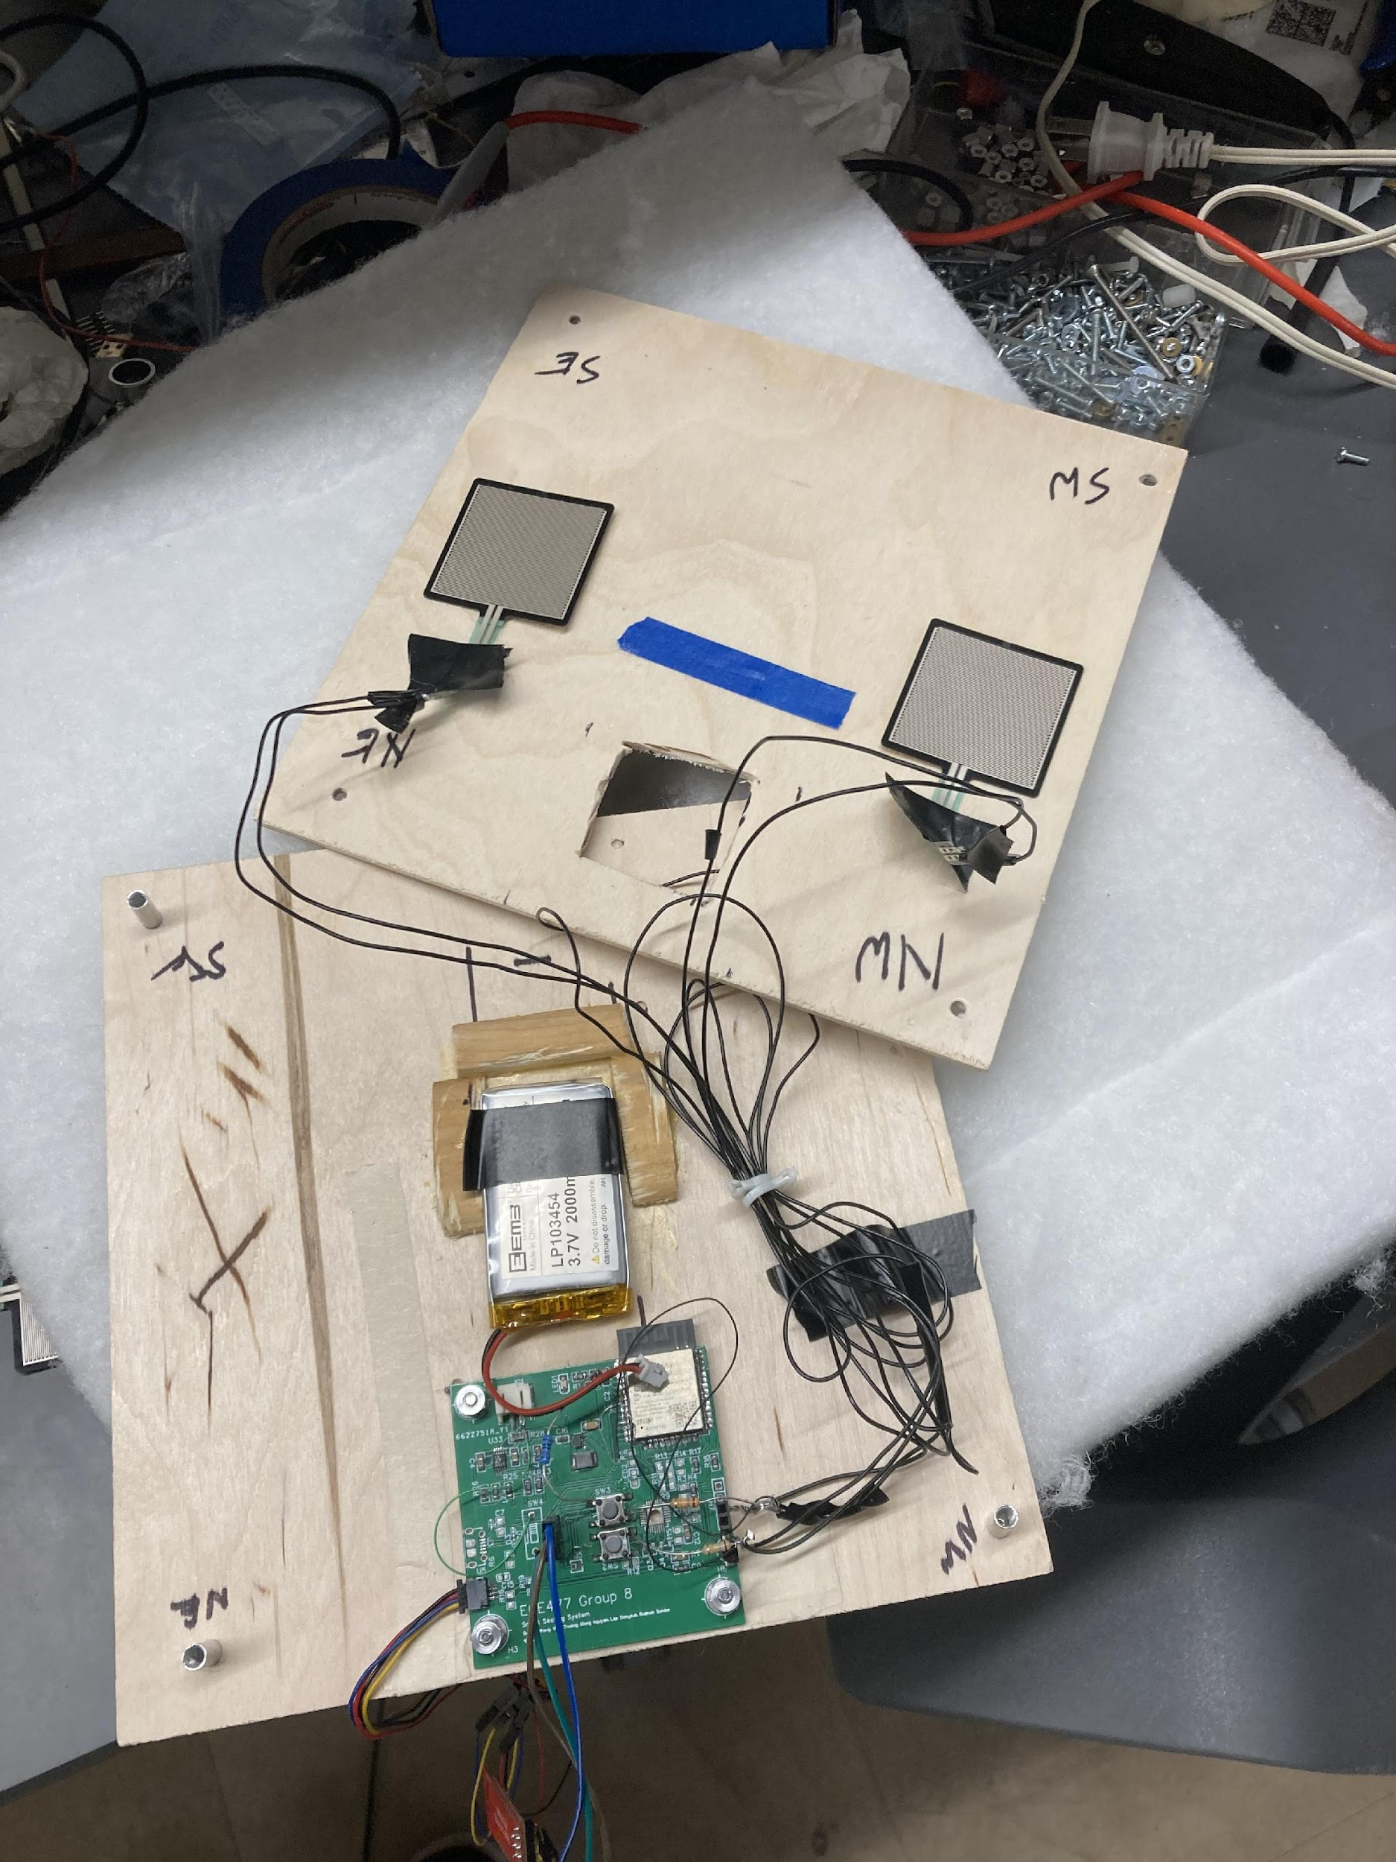
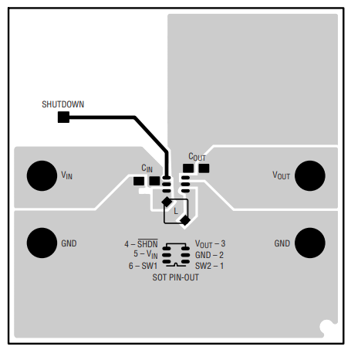
INDIVIDUAL CONTRIBUTIONS
LEE DONGEUN
Research on buck boost
PCB layout and planes
Mechanical Design and packaging
Soldering and debugging of PCB

Slide 8


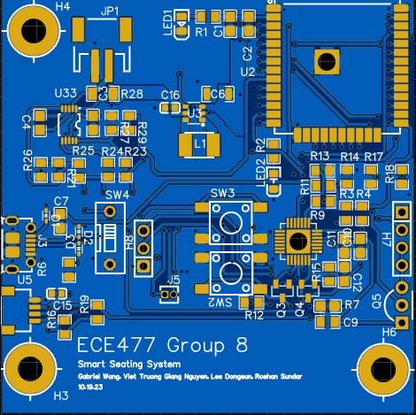
INDIVIDUAL CONTRIBUTIONS
GIANG NGUYEN
Component Research & Optimization
Schematics Generation
PCB Layers, Soldering & Debugging
Non-volatile Storage
Network Programming
Web Server
Python/JS/HTML/JSON
Progress Report

Slide 9
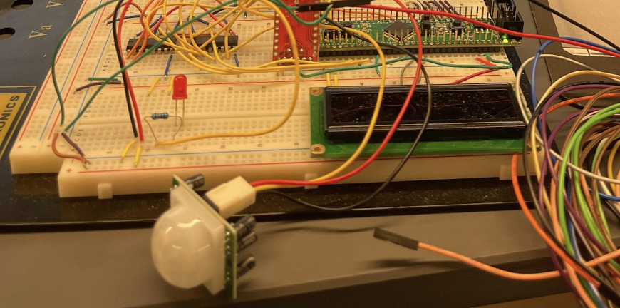
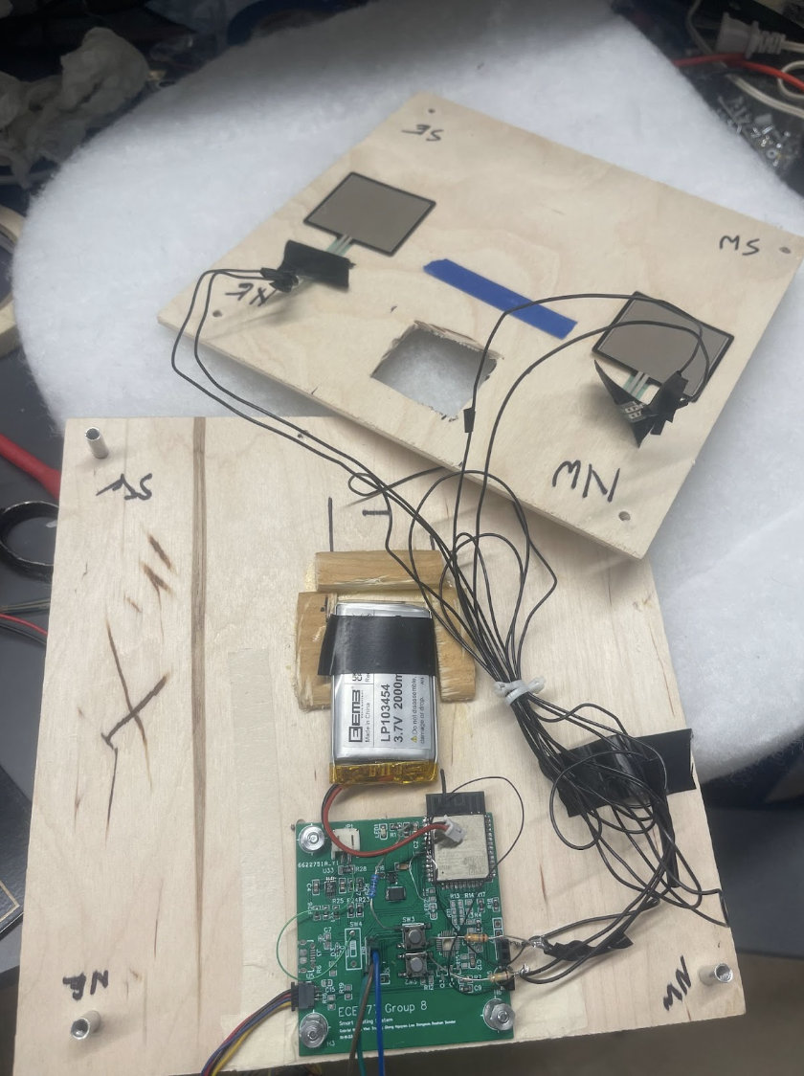
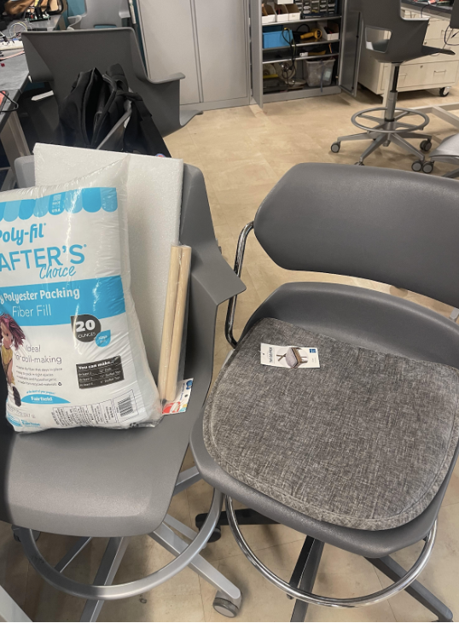
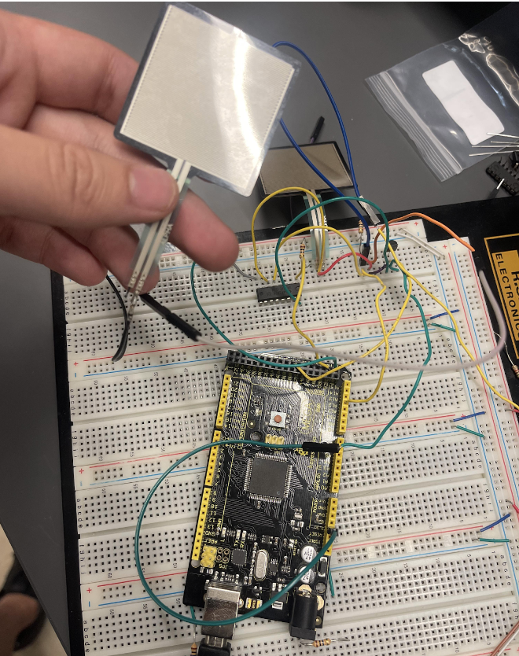
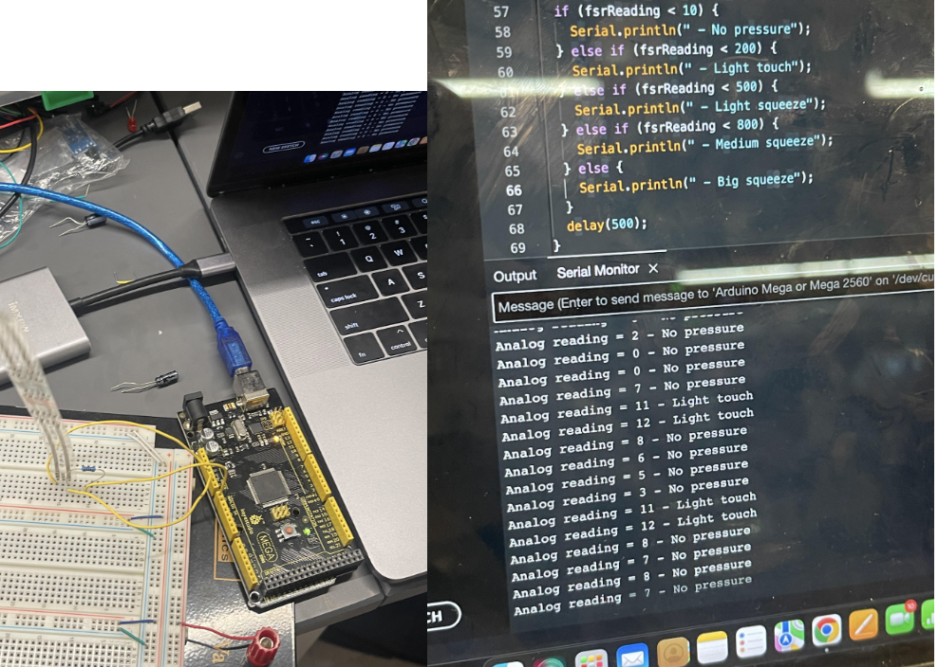
INDIVIDUAL CONTRIBUTIONS
GABRIEL WANG
PCB/Circuit Debugging and Mechanical Design/Packaging.
System Design and Initial Prototyping

Slide 10
PROJECT DEMONSTRATION
PSDR #1 (Hardware): An ability to interface between a ESP32 micro and a Force Sensitive Resistor via ADC and voltage divider [Seat-Mounted]
PSDR #2 (Hardware): An ability to interface between a ESP32 micro and a Thermal Camera via I2C bus [Seat-Mounted]
PSDR #3 (Hardware): An ability to interface between a 3.7V li-ion battery power supply and micro/sensors via a 3.3V Buck-Boost Converter [Seat-Mounted]
PSDR #4 (Hardware): An ability to measure the power supply SOC via Interrupt with coulomb counting [Seat-Mounted]
PSDR #5 (Software): An ability to display occupancy status of seats via a smartphone application [Front-End]

Slide 11

PROJECT DEMONSTRATION VIDEO

Slide 12
Questions?

